Slide 1
OC - Project 5
E-commerce customers segmentation
Exploratory Analysis
of a Public DataBASE from OLIST
A Brazilian E-Commerce
Stephane Lanchec

Slide 2

Objective
To PROVIDE Olist MANAGEMENT WITH A CUSTOMERS SEGMENTATION TO IMPROVE THEIR MARKETING Communication STRATEGY
How?
Use of Olist public data set
Customers, orders, products records
Delivery, review scores, geographic records…
Understand consumers behaviors
Understand customers needs and expectations
Divide OLIST clientele base into groups

Slide 3
Process Overview
Exploratory data, analysis, merging, cleaning
STEP 1
MANUAL RFM CLASSIFICATION (Recency, Frequency, Monetary)
Quantile Segmentation, RFM Score
STEP 2
CLASSIC UNSUPERVISED RFM – 3 Components
Clustering algorithms: K-Means, DBScan, HDBScan
STEP 3
ENHANCED UNSUPERVISED RFM - 6 Components
Clustering algorithms: K-Means, DBSCan, HDBScan
Feature engineering: Recency, Frequency, Monetary
Recency, Frequency, Monetary + Delivery, Review score, Total items
Pre-processing (Standardization), dimension reduction - tSNE visualization
Pre-processing (Standardization, PCA…), tSNE visualization
Segmentation
Clusters description
Marketing actions
Time Stability Maintenance Plan

Slide 4
Process STEP 1
Exploratory data, analysis, merging, cleaning
STEP 1
MANUAL RFM CLASSIFICATION (Recency, Frequency, Monetary)
Quantile Segmentation, RFM Score
STEP 2
CLASSIC UNSUPERVISED RFM – 3 Components
Clustering algorithms: K-Means, DBScan, HDBScan
STEP 3
ENHANCED UNSUPERVISED RFM - 6 Components
Clustering algorithms: K-Means, DBSCan, HDBScan
Feature Engineering: Recency, Frequency, Monetary
Recency, Frequency, Monetary + Delivery, Review score, Total items
Pre-processing (Standardization
Pre-processing (Standardization, PCA…)
Segmentation
Clusters description
Marketing actions

Slide 5
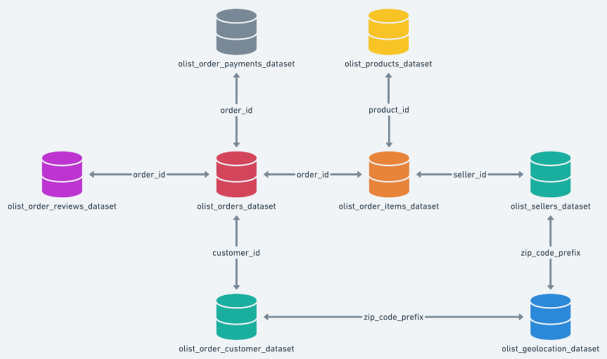
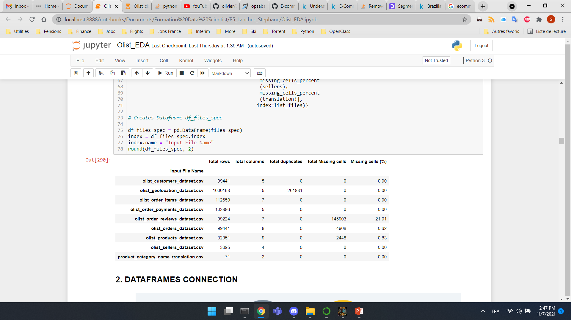
Dataset available
9 csv files as input files
Exemple of olist_customers_dataset.csv
Multiple dataset for better understanding and organization

Slide 6
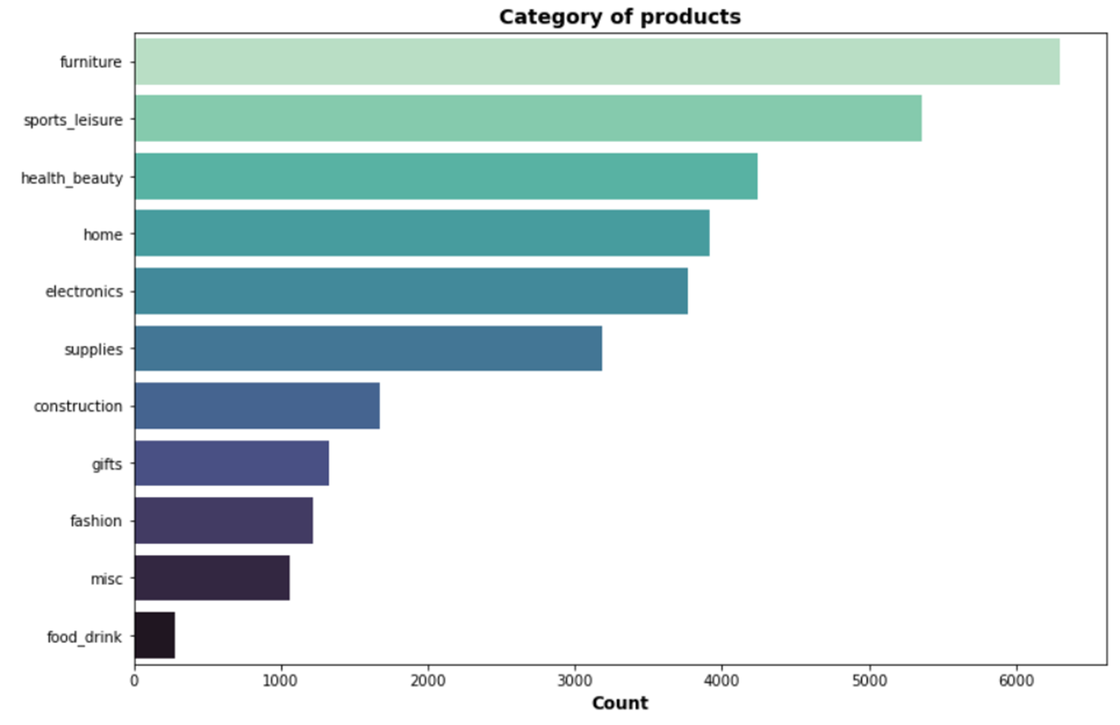
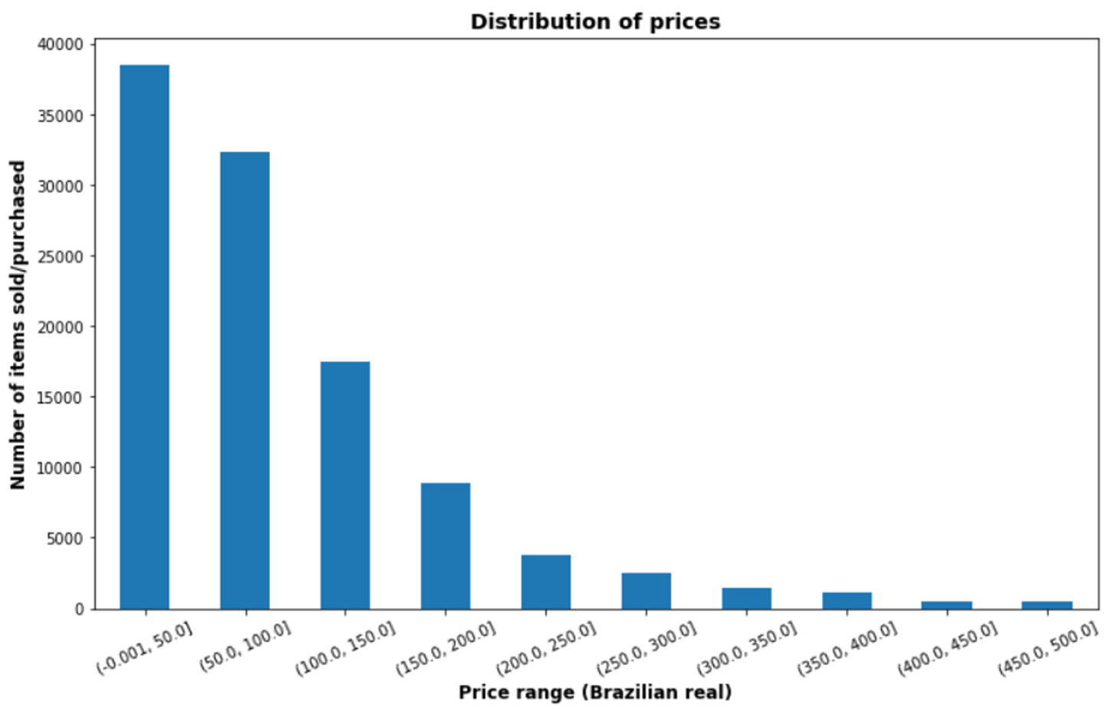
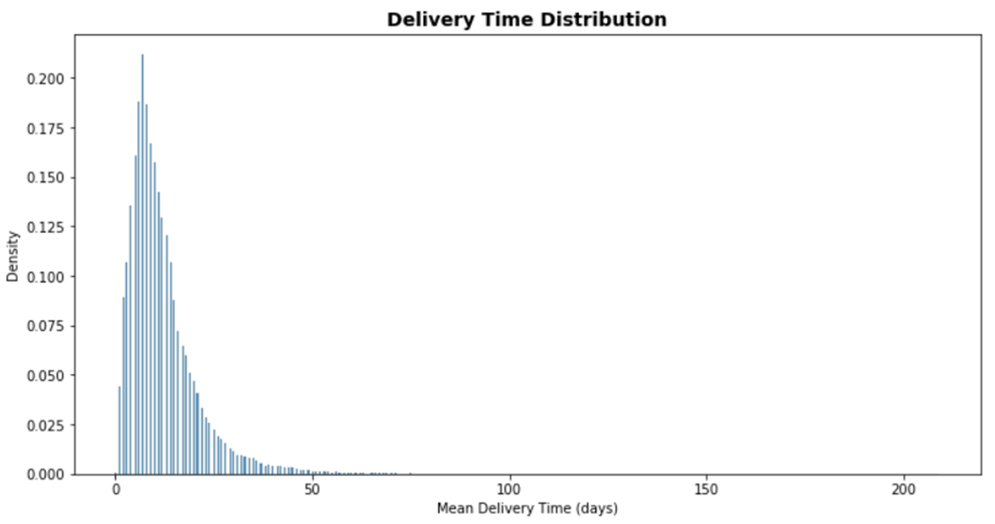
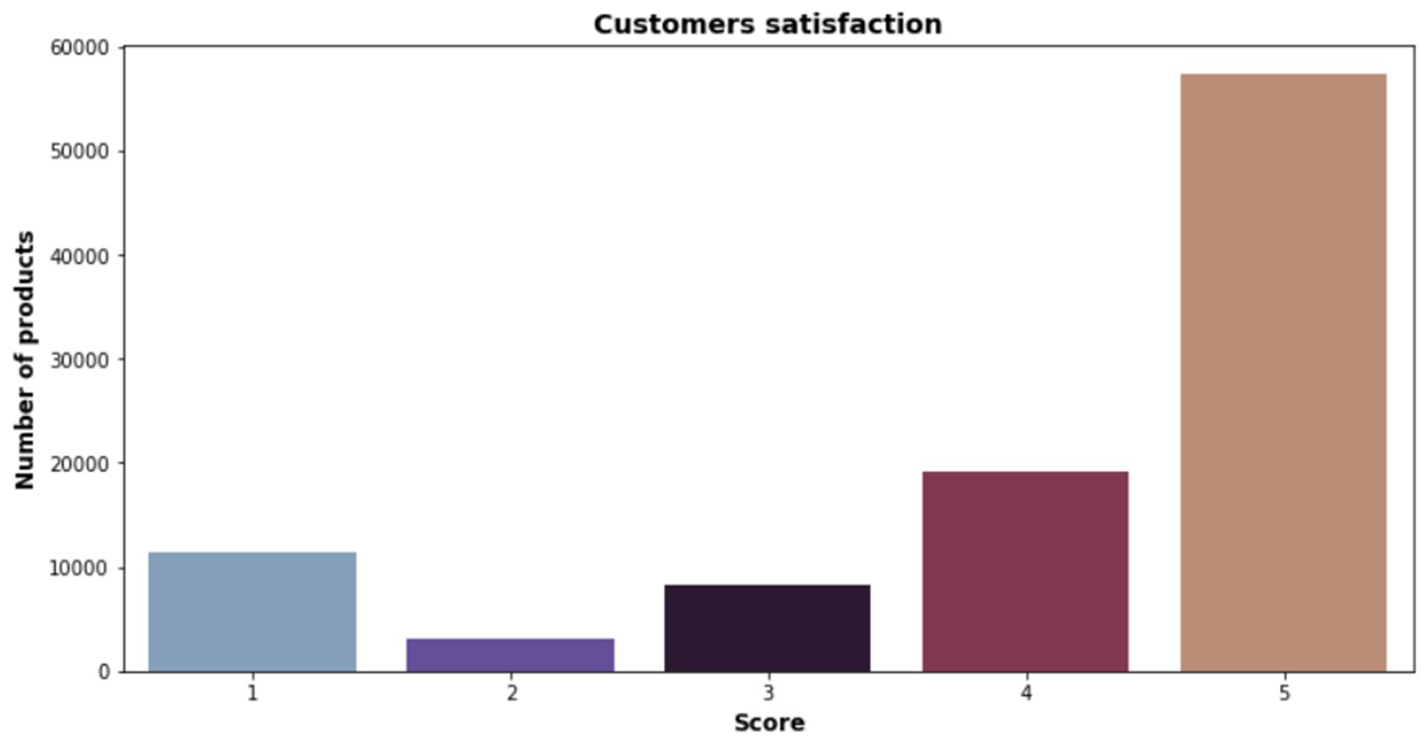
DATA SET EXPLORATION
What is sold on Olist?
Price range of products?
Data extraction
Data cleaning
How long to get a product?
Are customers satisfied?

Slide 7


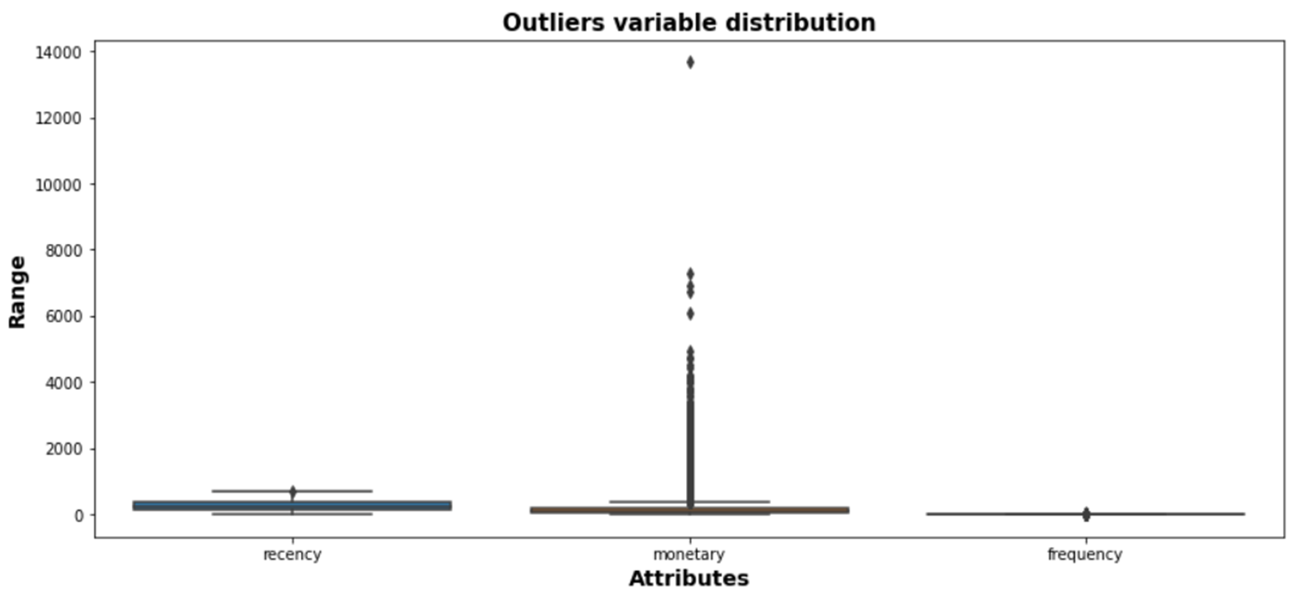
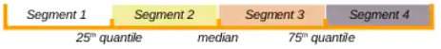
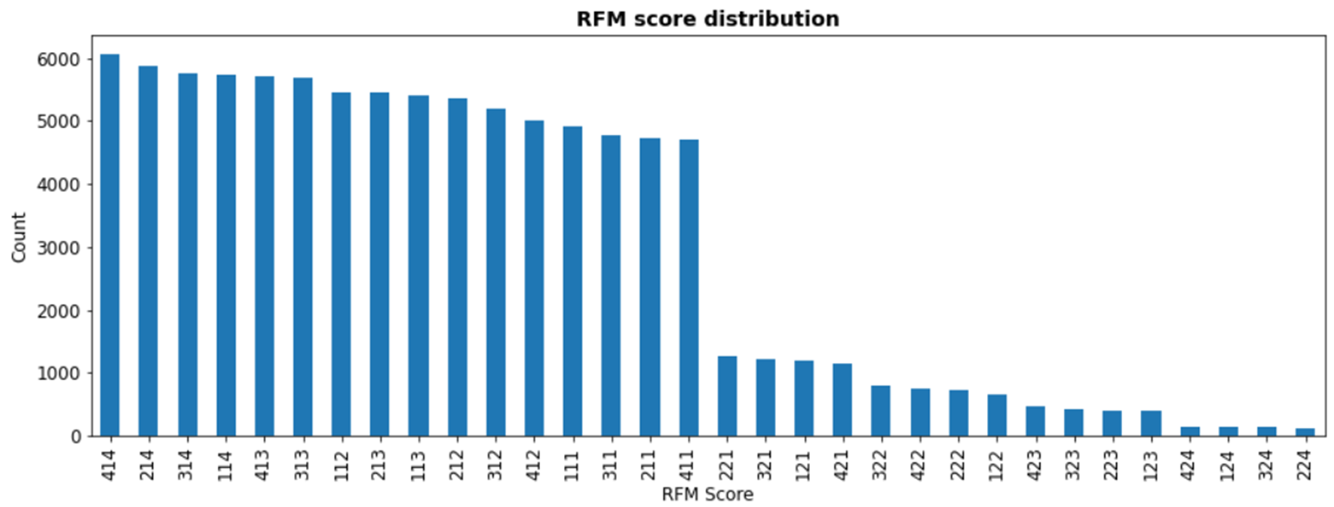
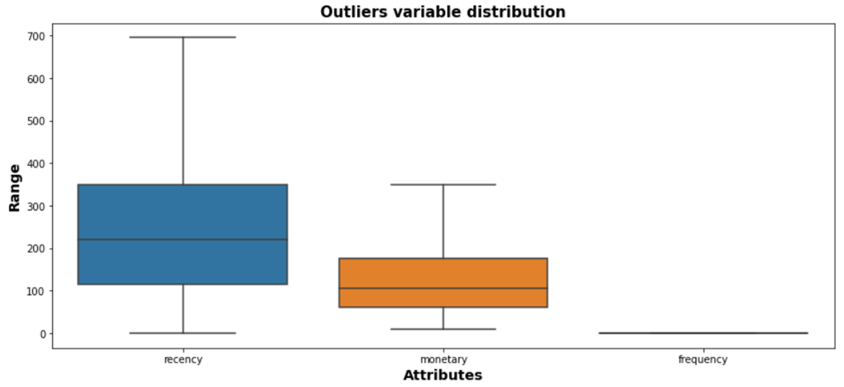
RFM - Quantile segmentation
Recency — TIME SINCE LAST ACTIVITY
Frequency — TOTAL number of REcORDED transactions
Monetary — TOTAL TRANSACTION VALUE
Recency= 1: Short time since last purchase
Recency= 4: Long time since last purchase
Frequency= 1: One single purchase
Frequency= 2: Multiple purchases
Monetary= 1: High value purchase
Monetary= 4: Low value purchase
Outlier
removed
= 1 transaction
> 1 transaction

Slide 8
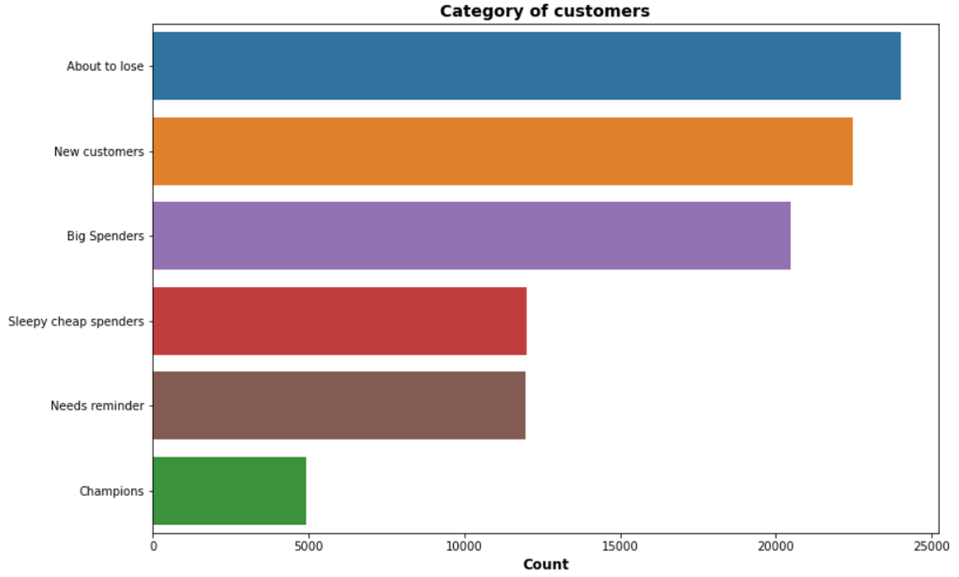
CLUSTERING DESCRIPTION
About to lose: Bought a long time ago, once or more and never came back
New customers: Bought recently, once or more
Big spenders: Bought quite recently, only once but spent "big" money
Sleepy cheap spenders: Bough a while ago but spent little money
Needs reminder: Bought a while ago, once or more and spent a fair bit of money
Champions: Bought recently, more than once and spent "big" money

Slide 9
Process STEP 2
Exploratory data analysis, merging, cleaning
STEP 1
MANUAL RFM CLASSIFICATION(Recency, Frequency, Monetary)
Quantile Segmentation, RFM Score
STEP 2
CLASSIC UNSUPERVISED RFM – 3 Components
Clustering algorithms: K-Means, DBScan, HDBScan
STEP 3
ENHANCED UNSUPERVISED RFM - 6 Components
Clustering algorithms: K-Means, DBSCan, HDBScan
Feature Engineering: Recency, Frequency, Monetary
Recency, Frequency, Monetary + Delivery, Review score, Total items
Pre-processing (Standardization), dimension reduction - tSNE visualization
Pre-processing (Standardization, PCA…)
Segmentation
Clusters description
Marketing actions

Slide 10
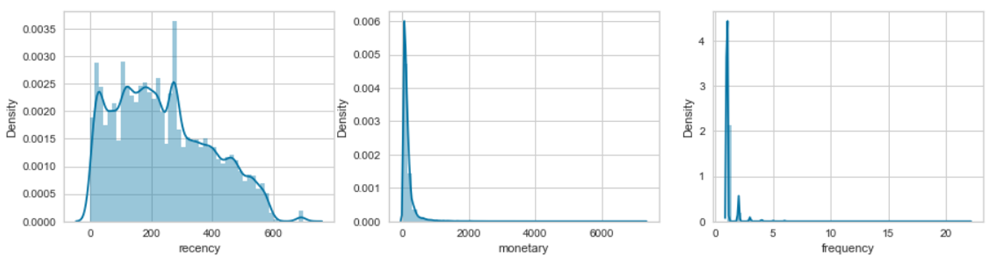
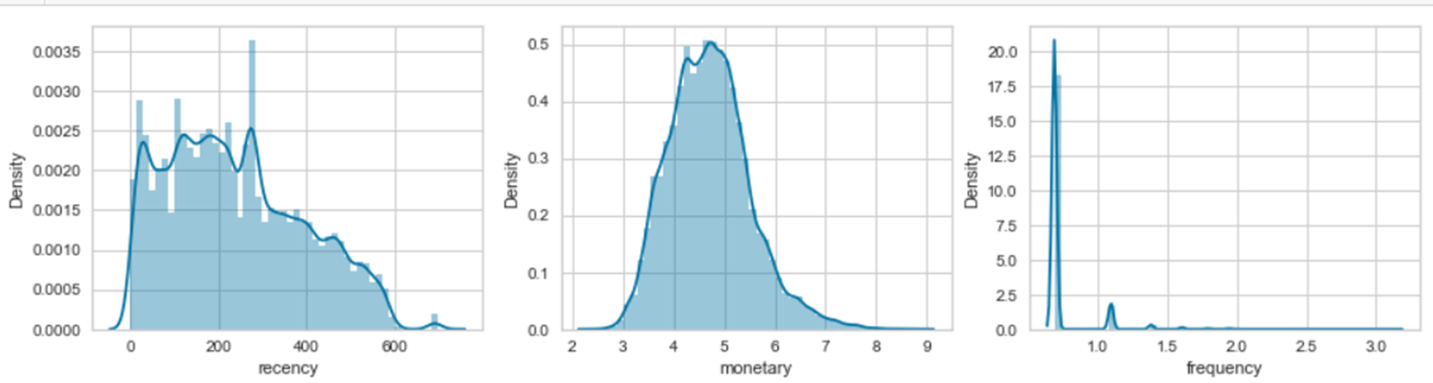
FEATURES SCALING DATA Pre-processing
K-Means
Favors roughly spherical-shaped clusters
Data with heavily skewed variables may lead to very elongated clusters that are not well captured by this method.
Keep in Lin scale
Log transformation
PRE-PROCESSING
Unskew the data - log transformation
Standardize to the same average values
Scale to the same standard deviation

Slide 11
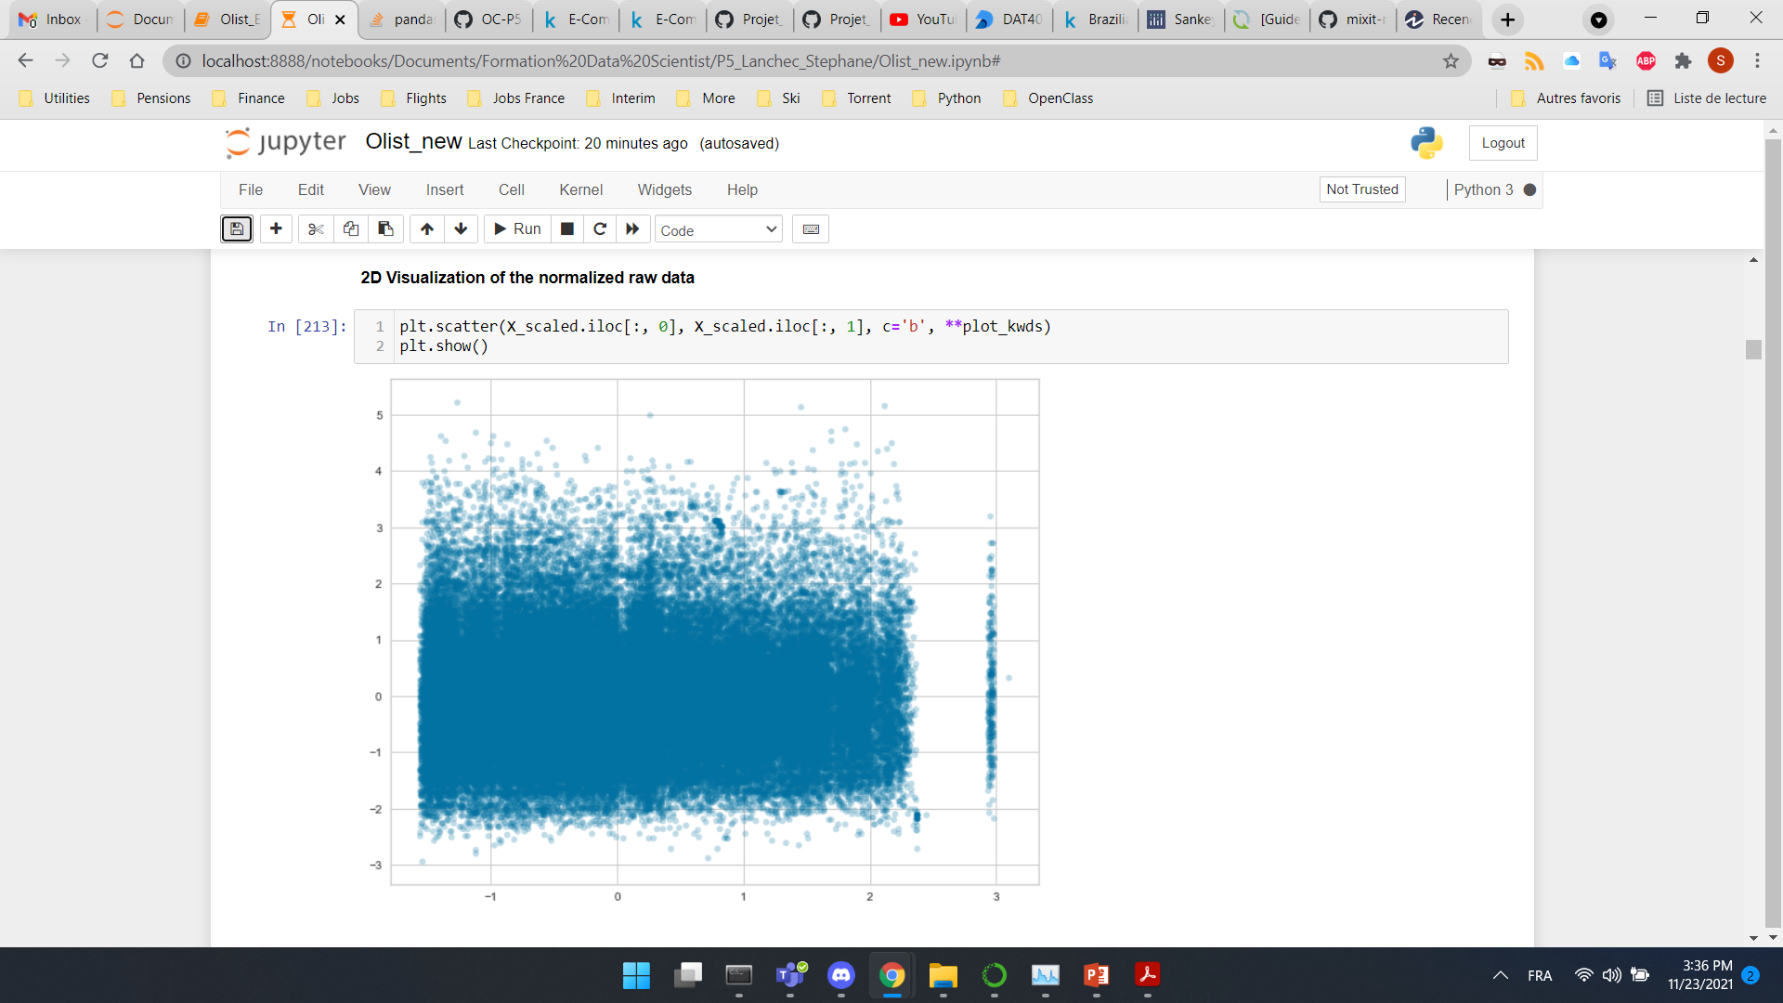
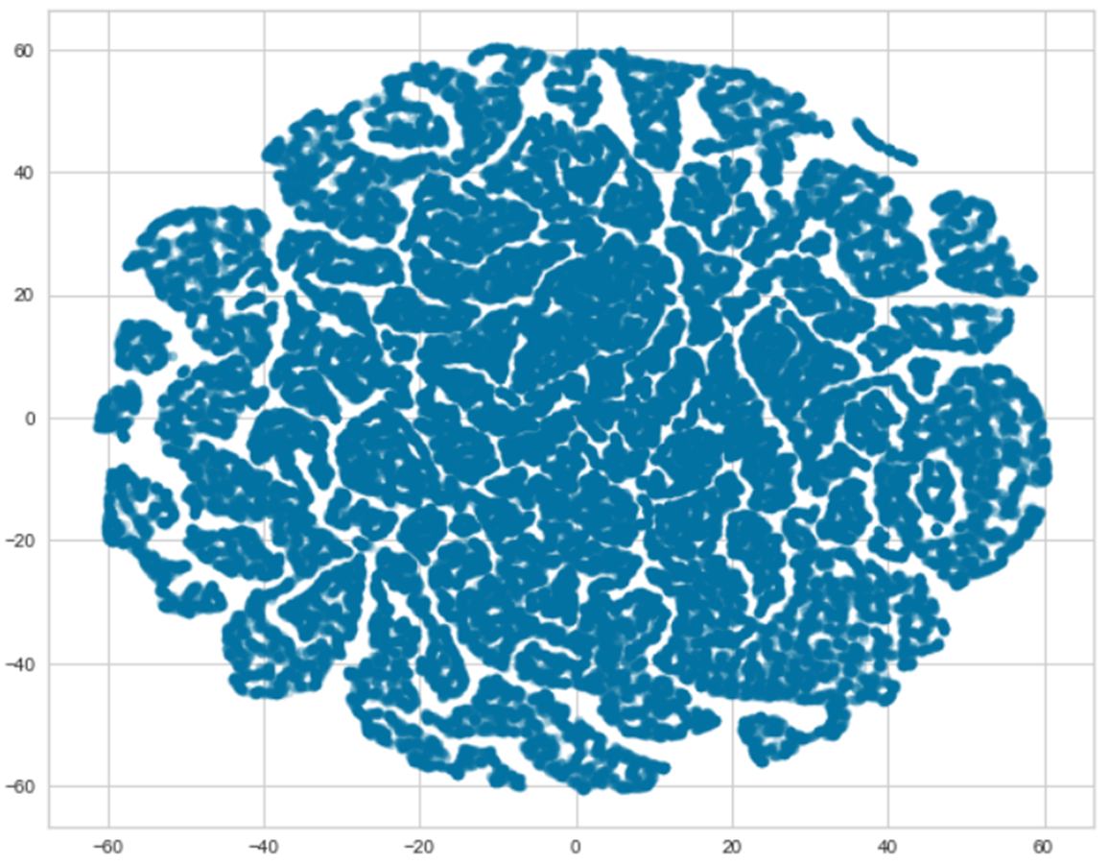
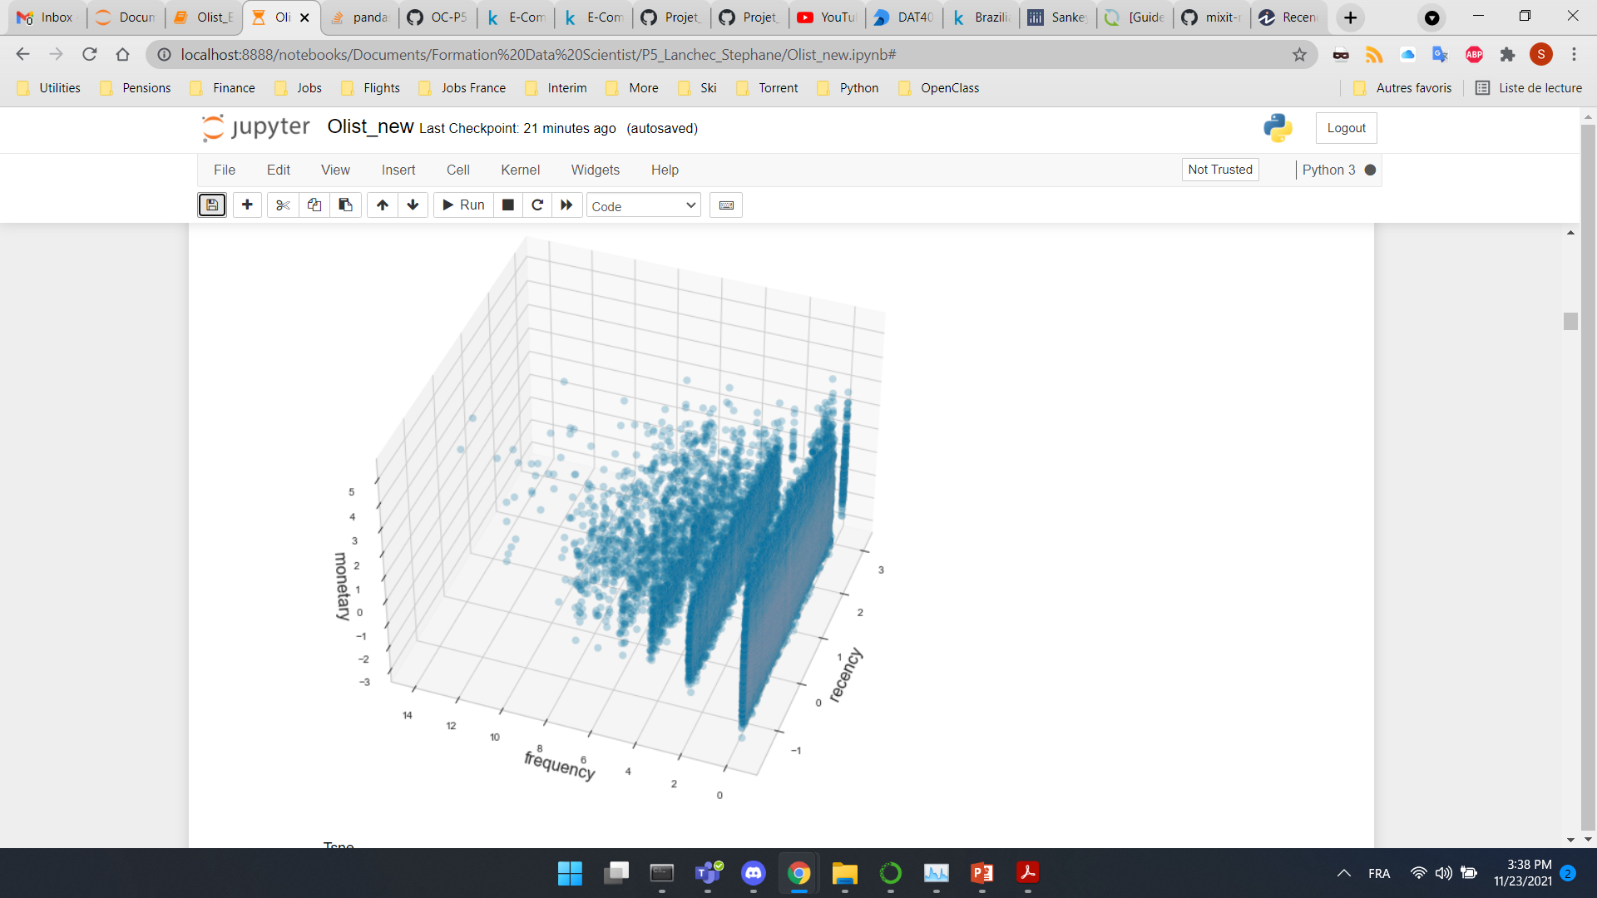
DATA VISUALIZATION BEFORE CLASSICAL RFM clustering
T-distributed Stochastic Neighbor Embedding (T-SNE) visualization plot
3D Scatter plot
2D Scatter plot
Dimensionality reduction technique for visualization of high-dimensional datasets
* First 2 components represented

Slide 12
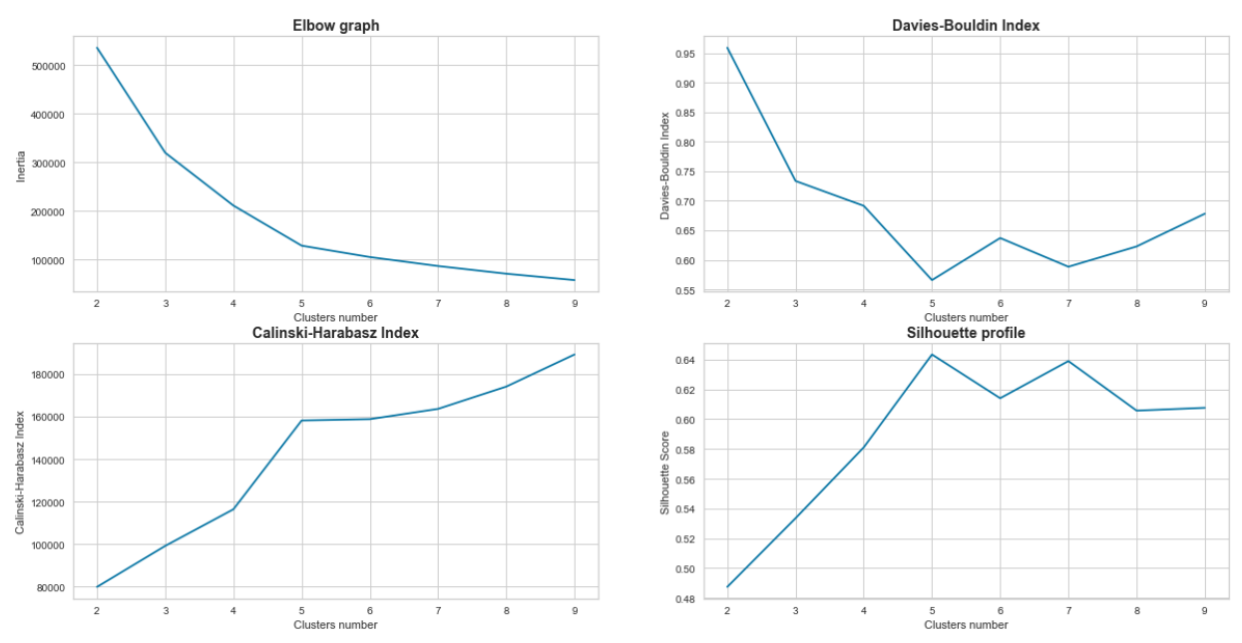
OPTIMAL NUMBER OF CLUSTERS CLASSICAL RFM CLUSTERING
Sum of square distances from each point to its assigned center.
Ratio of within-cluster distances to between-cluster distances
Inertia
Optimal
number
of
clusters:
5
Variance Ratio Criterion
Ratio of the sum of between-clusters dispersion and of within-cluster dispersion for all clusters
Measure how similar an object is to its own cluster (cohesion) compared to other clusters (separation)

Slide 13
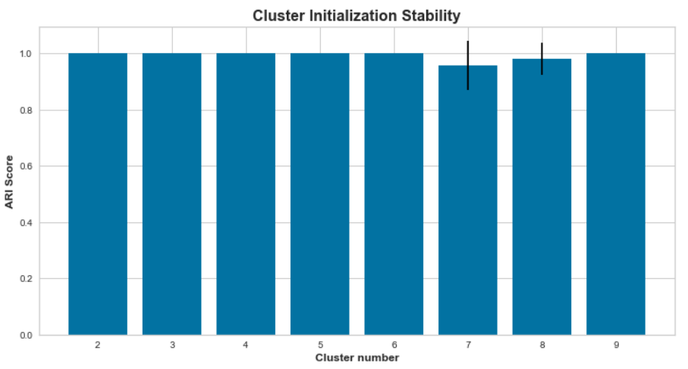
CLUSTER STABILITY INITIALIZATION CLASSICAL RFM CLUSTERING
Poor initialization can lead to increased numbers of required clustering iterations to reach convergence, a greater overall runtime, and a less-efficient algorithm overall.
Running this clustering 10 times
Compare the next 9 iterations to the initial segmentation
Compute Adjusted Rand Index:
If two clusterings completely agree on labels then the Rand index is 1
If the clusterings complete disagree the Rand index will be 0
Strong stability overall

Slide 14
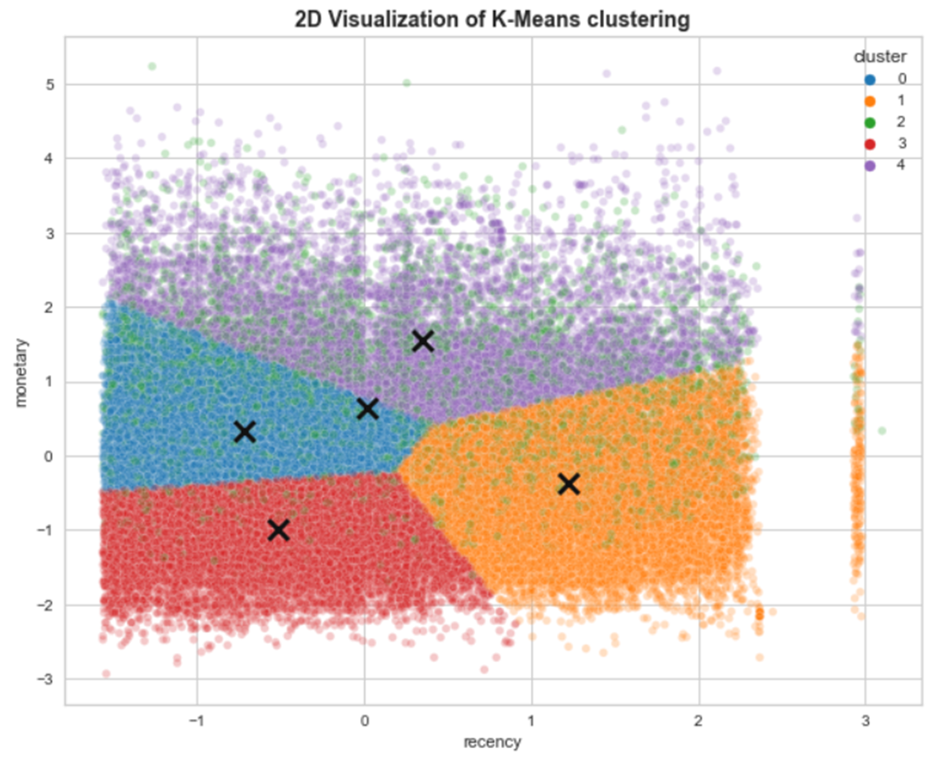
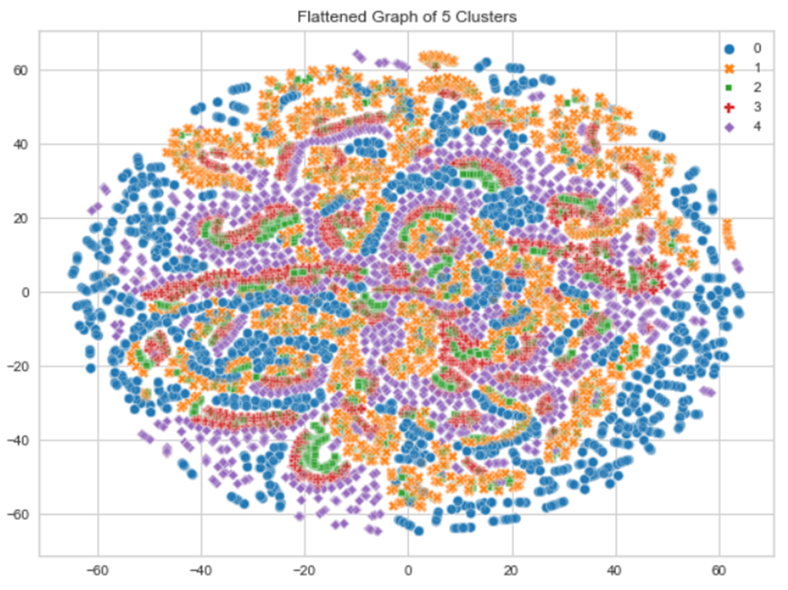
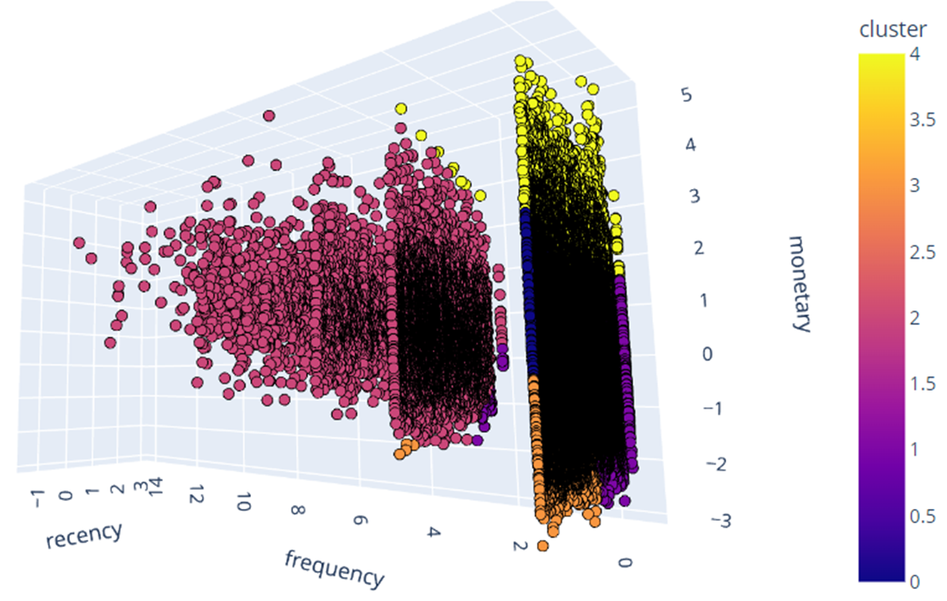
K-MEANS CLASSICAL RFM CLUSTERING
K-means is a centroid-based algorithm, or a distance-based algorithm, where we calculate the distances to assign a point to a cluster. Each cluster is associated with a centroid (x).
3D interactive plot
2D Scatter plot
with
defined clusters
2D t-SNE plot

Slide 15
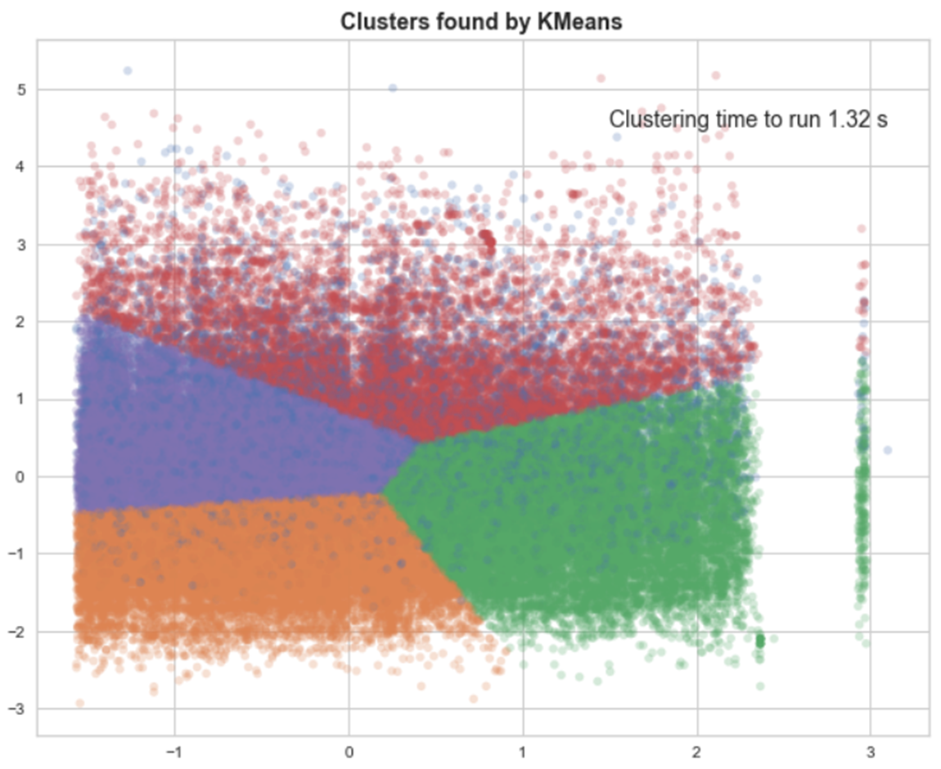
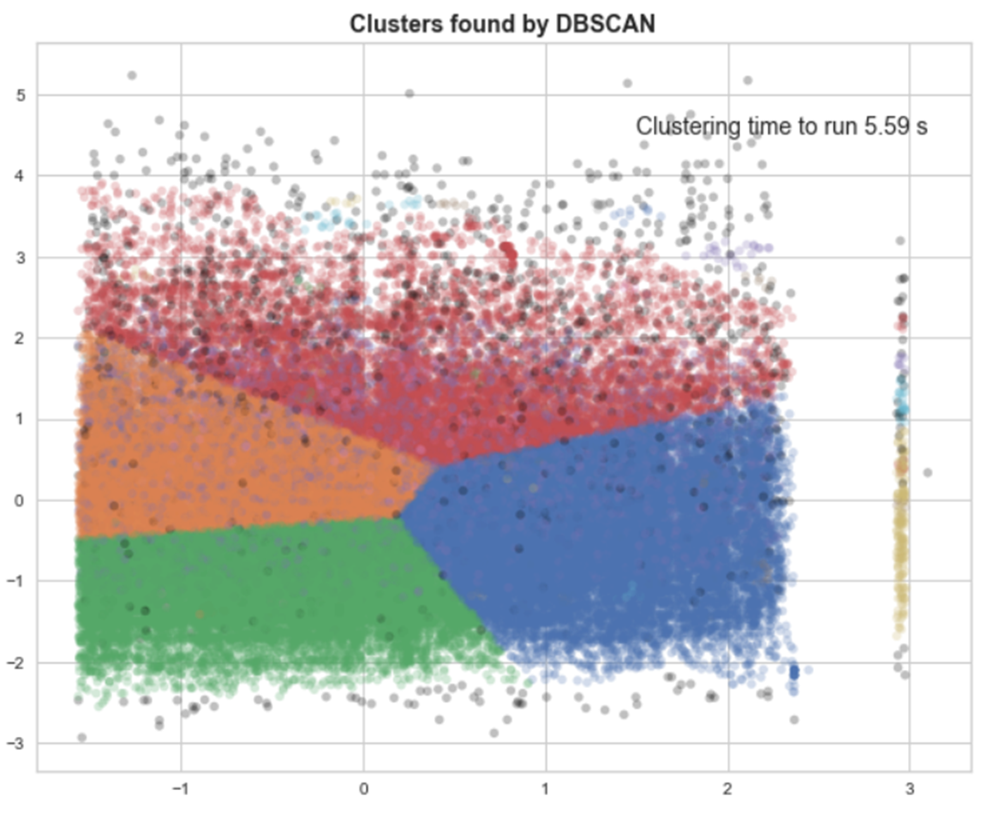
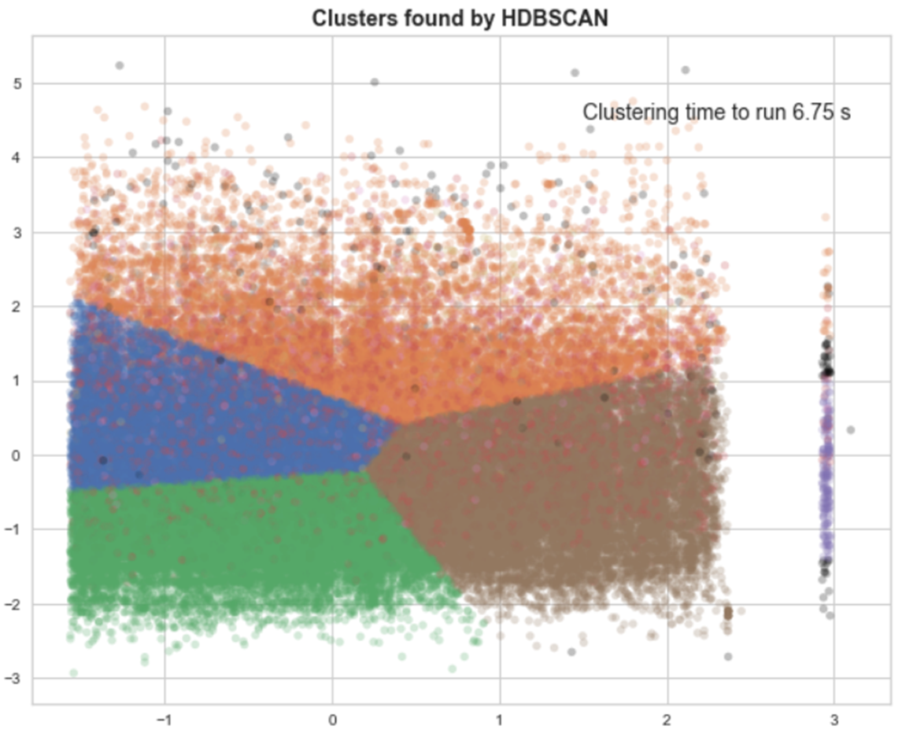
DBSCAN & HDBSCAN CLASSICAL RFM CLUSTERING
Clusters found by KMeans
Clusters found by DBScan
Clusters found by HDBScan
Extracts the ‘dense’ clusters and leaves sparse background classified as ‘noise’.
Labelled as black points
DBSCAN implementation for varying epsilon values

Slide 16
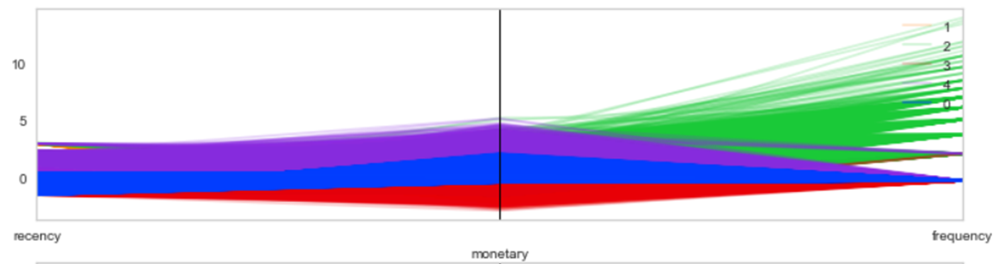
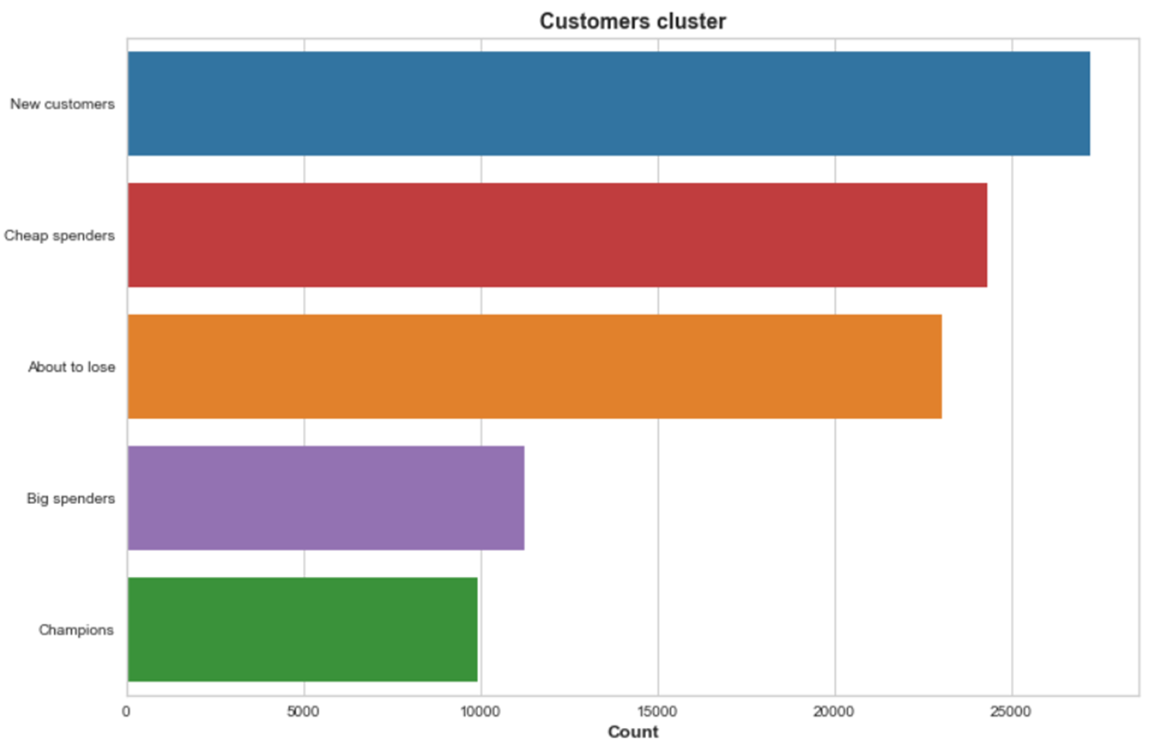
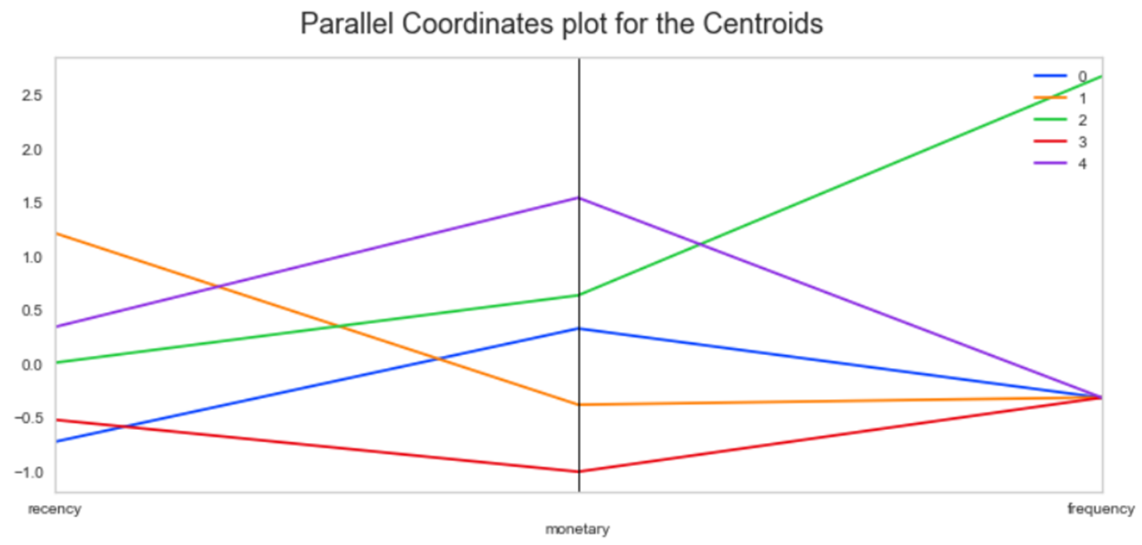
Understanding our clusters CLASSICAL RFM CLUSTERING
Parallel Coordinates Plot for the clusters
Cluster 0: New customers
Cluster 1: About to lose
Cluster 2: Champions
Cluster 3: Cheap Spenders
Cluster 4: Big Spenders
Parallel Coordinates Plot for the centroids

Slide 17
Process STEP 3
Exploratory data, analysis, merging, cleaning
STEP 1
MANUAL RFM CLASSIFICATION (Recency, Frequency, Monetary)
Quantile Segmentation, RFM Score
STEP 2
CLASSIC UNSUPERVISED RFM – 3 Components
Clustering algorithms: K-Means, DBScan, HDBScan
STEP 3
ENHANCED UNSUPERVISED RFM - 6 Components
Clustering algorithms: K-Means, DBSCan, HDBScan
Feature Engineering: Recency, Frequency, Monetary
Recency, Frequency, Monetary + Delivery, Review score, Total items
Pre-processing (Standardization
Pre-processing (Standardization, PCA…), tSNE visualization
Segmentation
Clusters description
Marketing actions

Slide 18
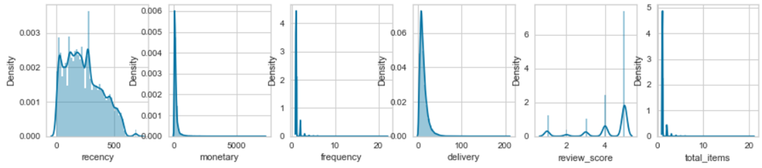
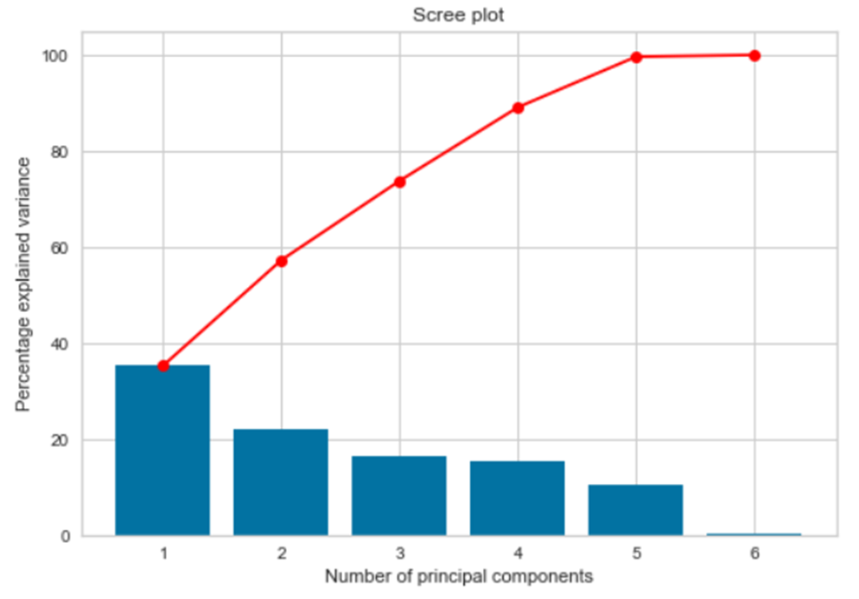
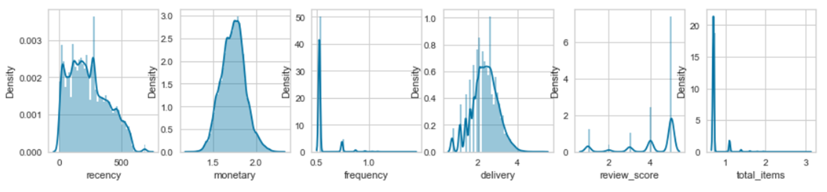
ENHANCED RFM CLUSTERING
Classical RFM
recency
frequency
monetary
Features added
delivery
review score
Nbr items
Enhanced RFM
DATA PRE-PROCESSING
Log transform skewed distribution
PCA dimensionality reduction
PHASE 1
PHASE 2

Slide 19
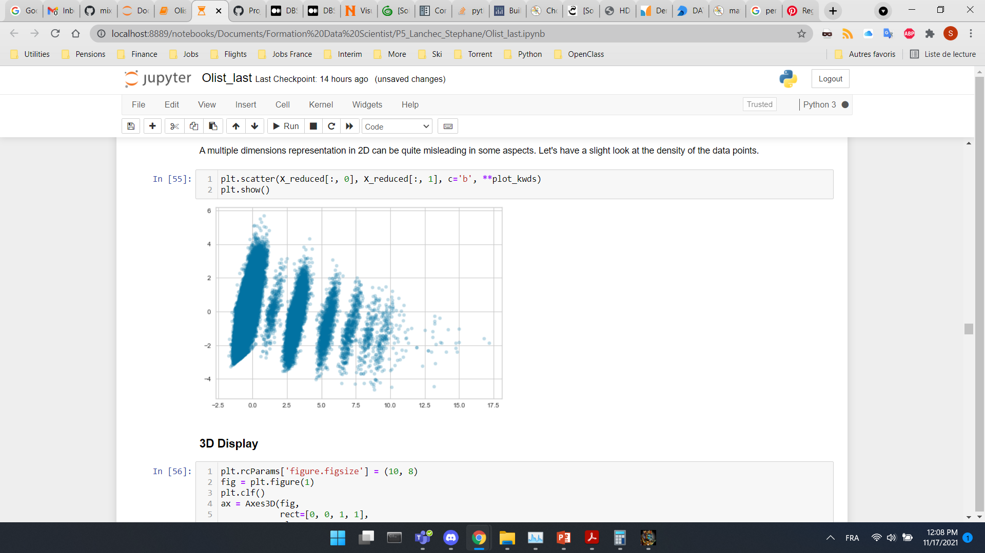
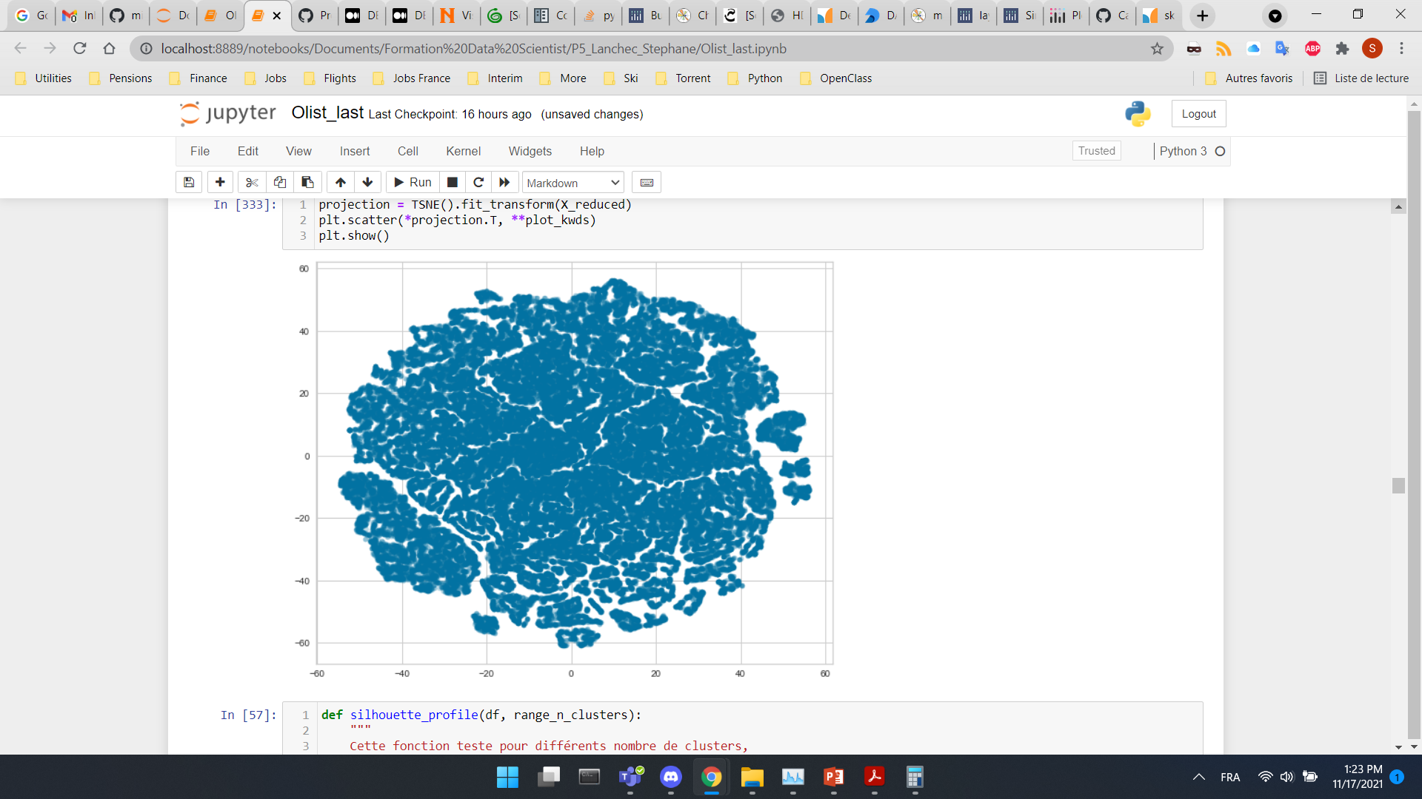
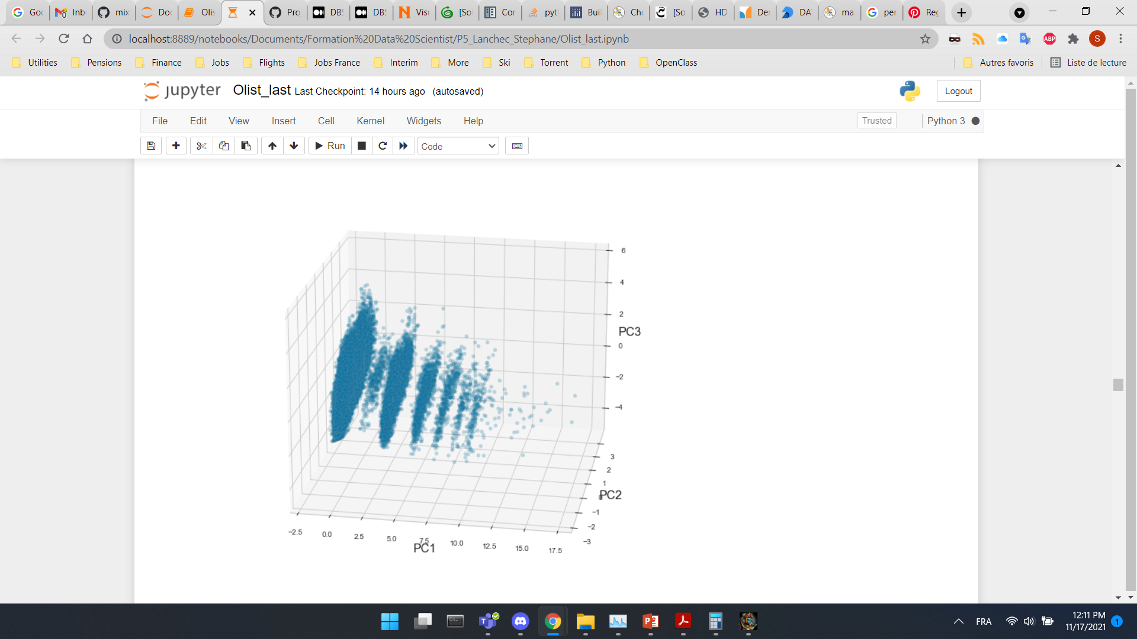
DATA VISUALIZATION BEFORE ENHANCED RFM clustering
Data after PCA
3D Scatter plot
2D Scatter plot
2D t-SNE plot
* First 2 components represented

Slide 20
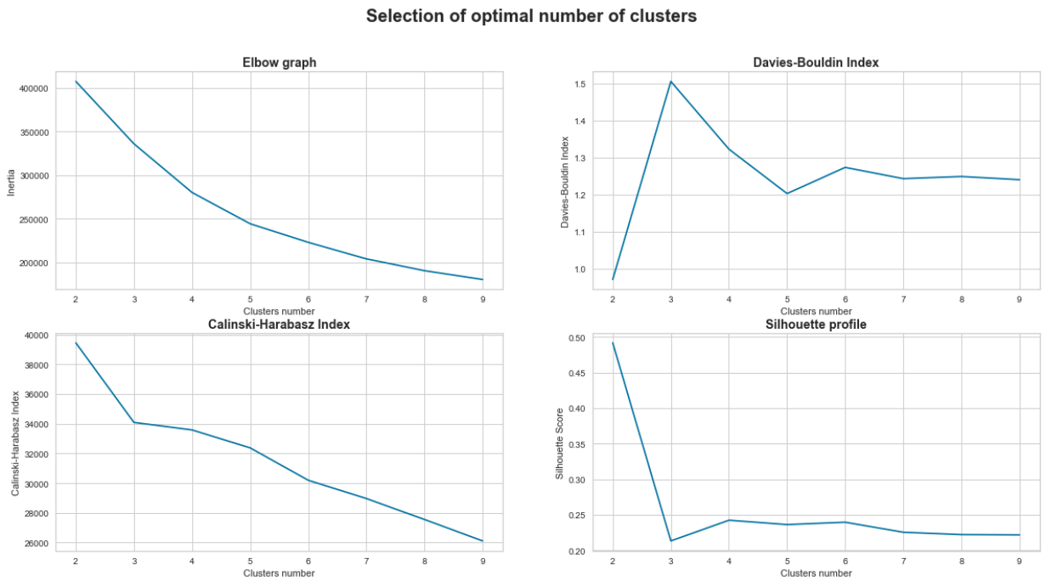
KMEANS - SELECTION OF CLUSTERS NUMBER ENHANCED RFM clustering
Number
of
clusters:
5
?

Slide 21
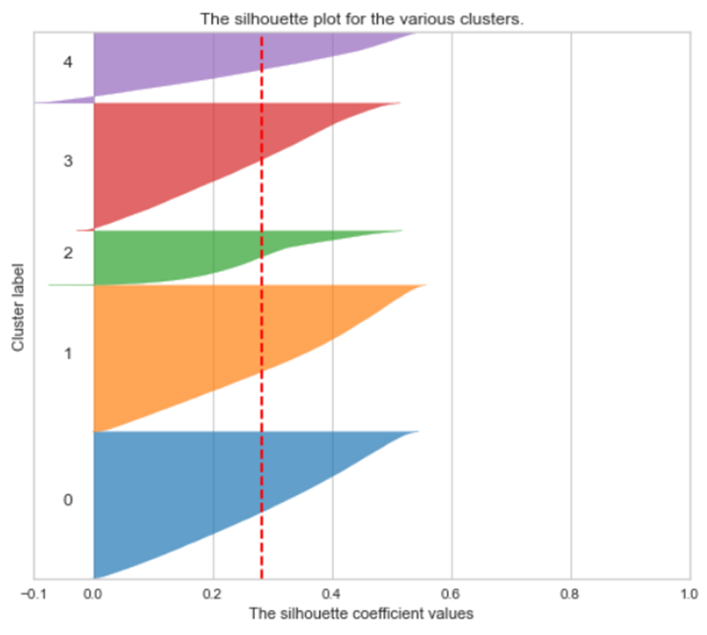
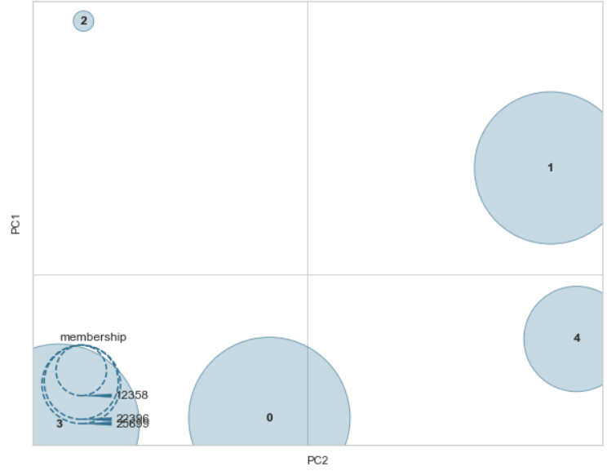
CLUSTERS QUALITY ENHANCED RFM clustering
Silhouette plot nb_clusters=5
Kmeans intercluster Distance Map
Above average silhouette score
Homogeneity
Decent separation
Homogeneity

Slide 22
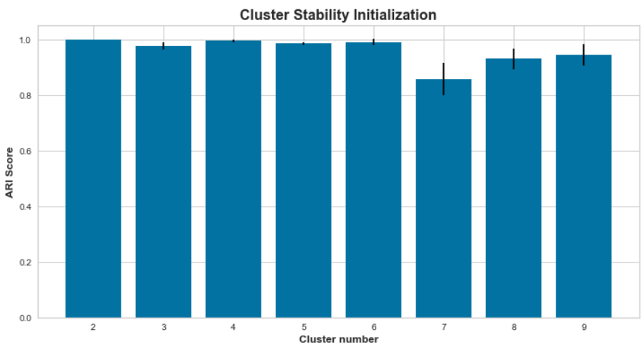
CLUSTER STABILITY INITIALIZATION ENHANCED RFM clustering
Running this clustering 10 times
Compare the next 9 iterations to the initial segmentation
Compute Adjusted Rand Index:
If two clusterings completely agree on labels then the Rand index is 1
If the clusterings complete disagree the Rand index will be 0
Strong stability until 6 clusters

Slide 23
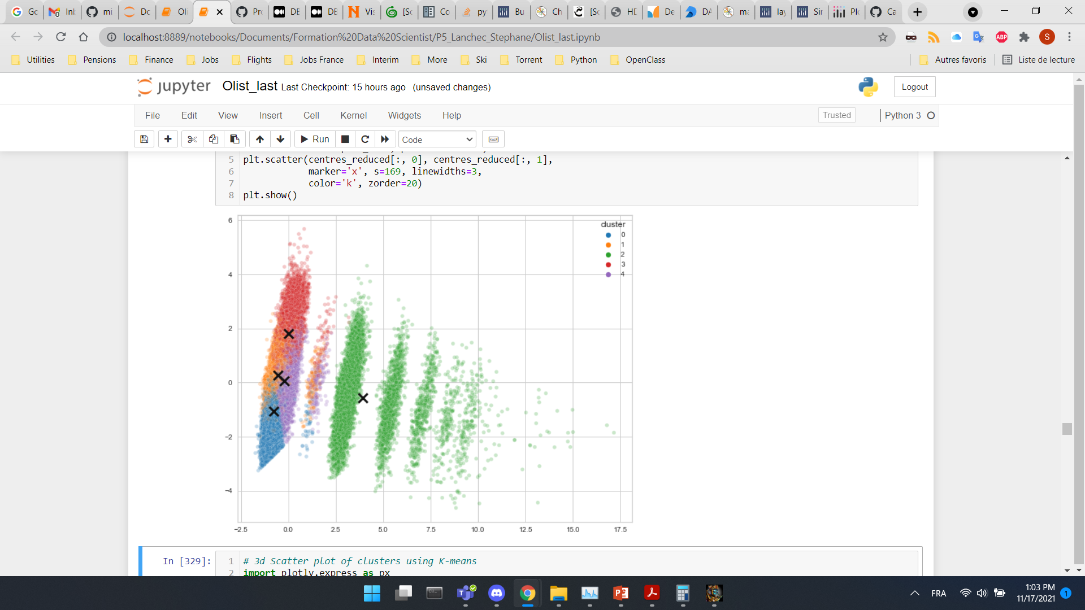
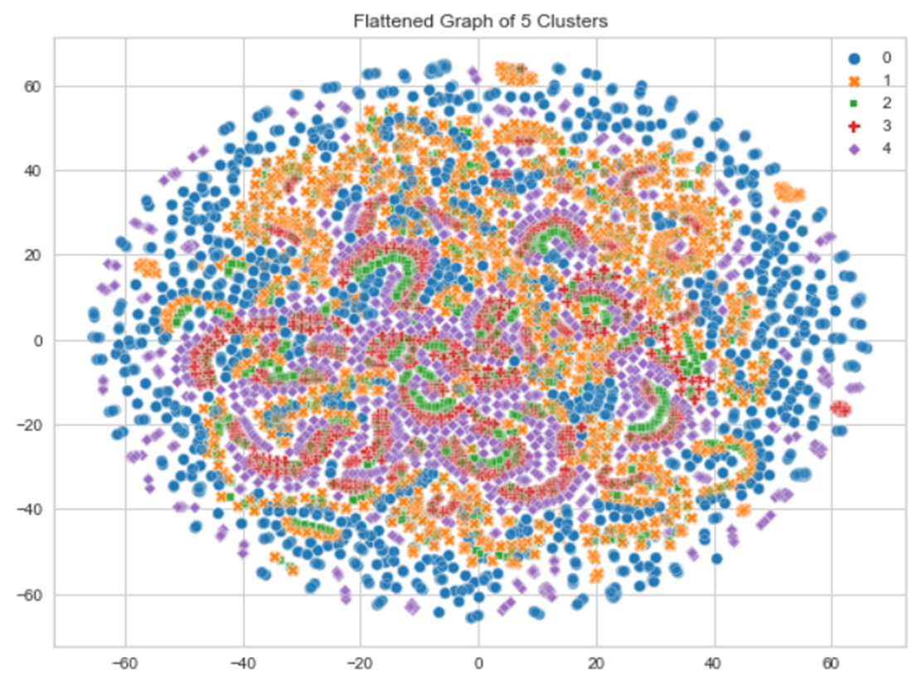
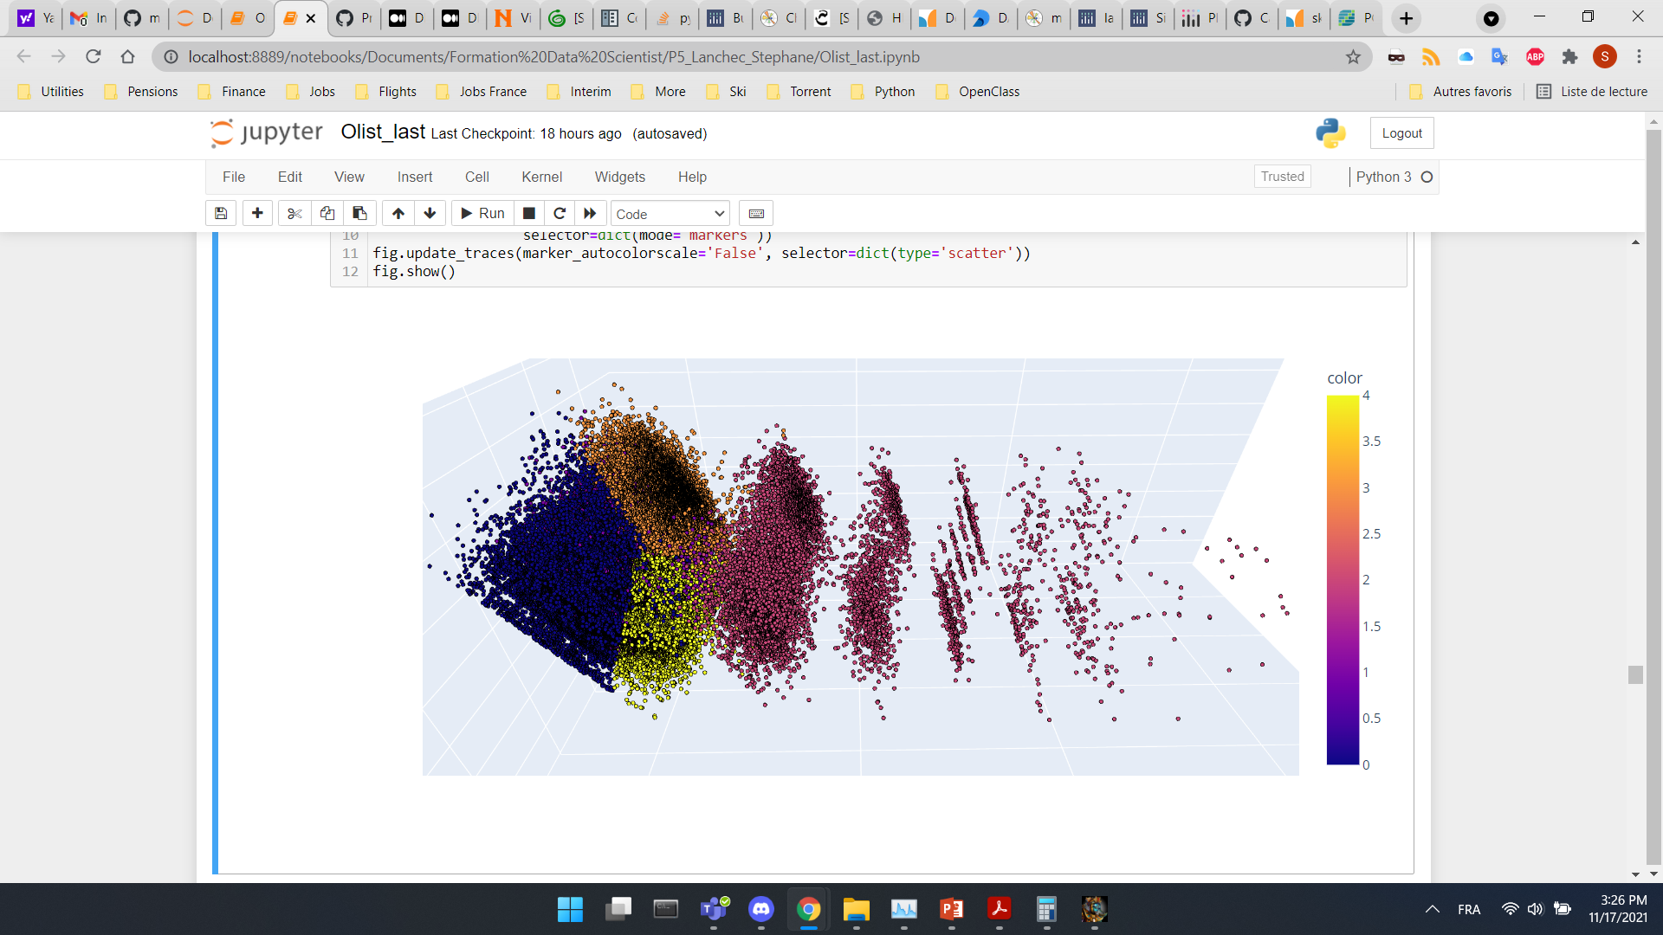
Model Training & CLUSTERS SEPARATION ENHANCED RFM clustering
3D Scatter plot
2D Scatter plot
after KMeans with associated centroids
2D t-SNE plot
after KMeans

Slide 24
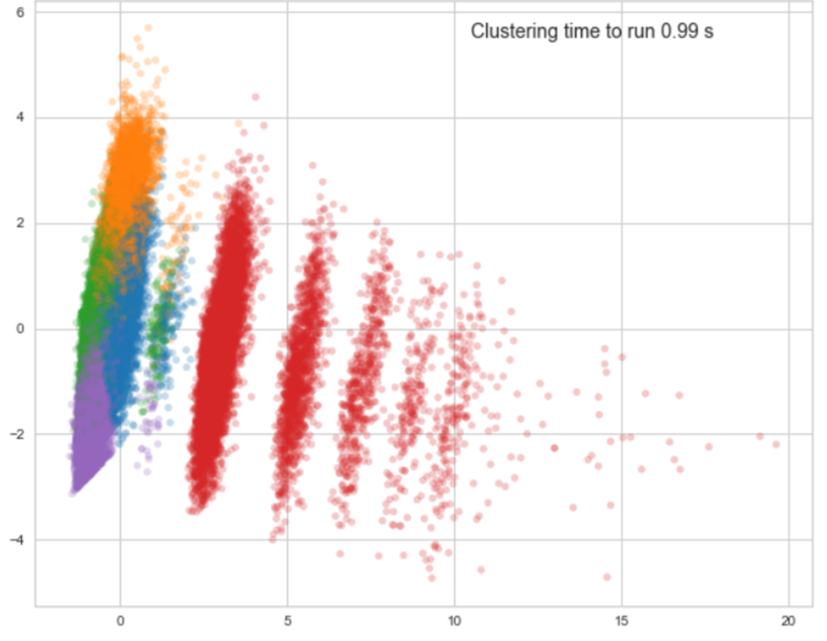
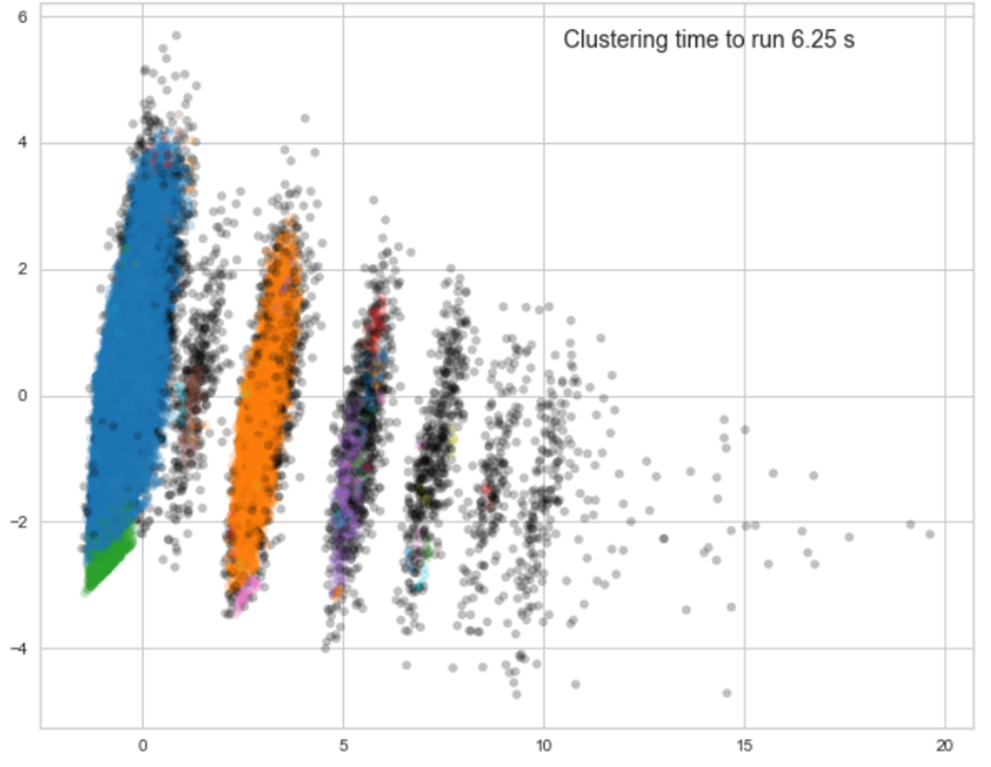
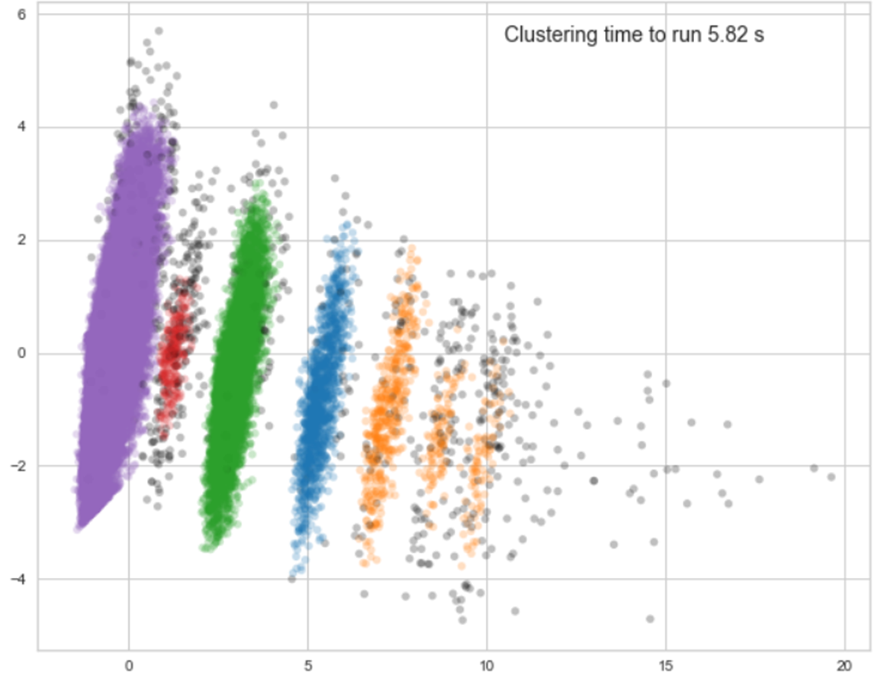
DBSCAN & HDBSCAN ENHANCED RFM CLUSTERING
Clusters found by KMeans
Clusters found by DBScan
Clusters found by HDBScan

Slide 25
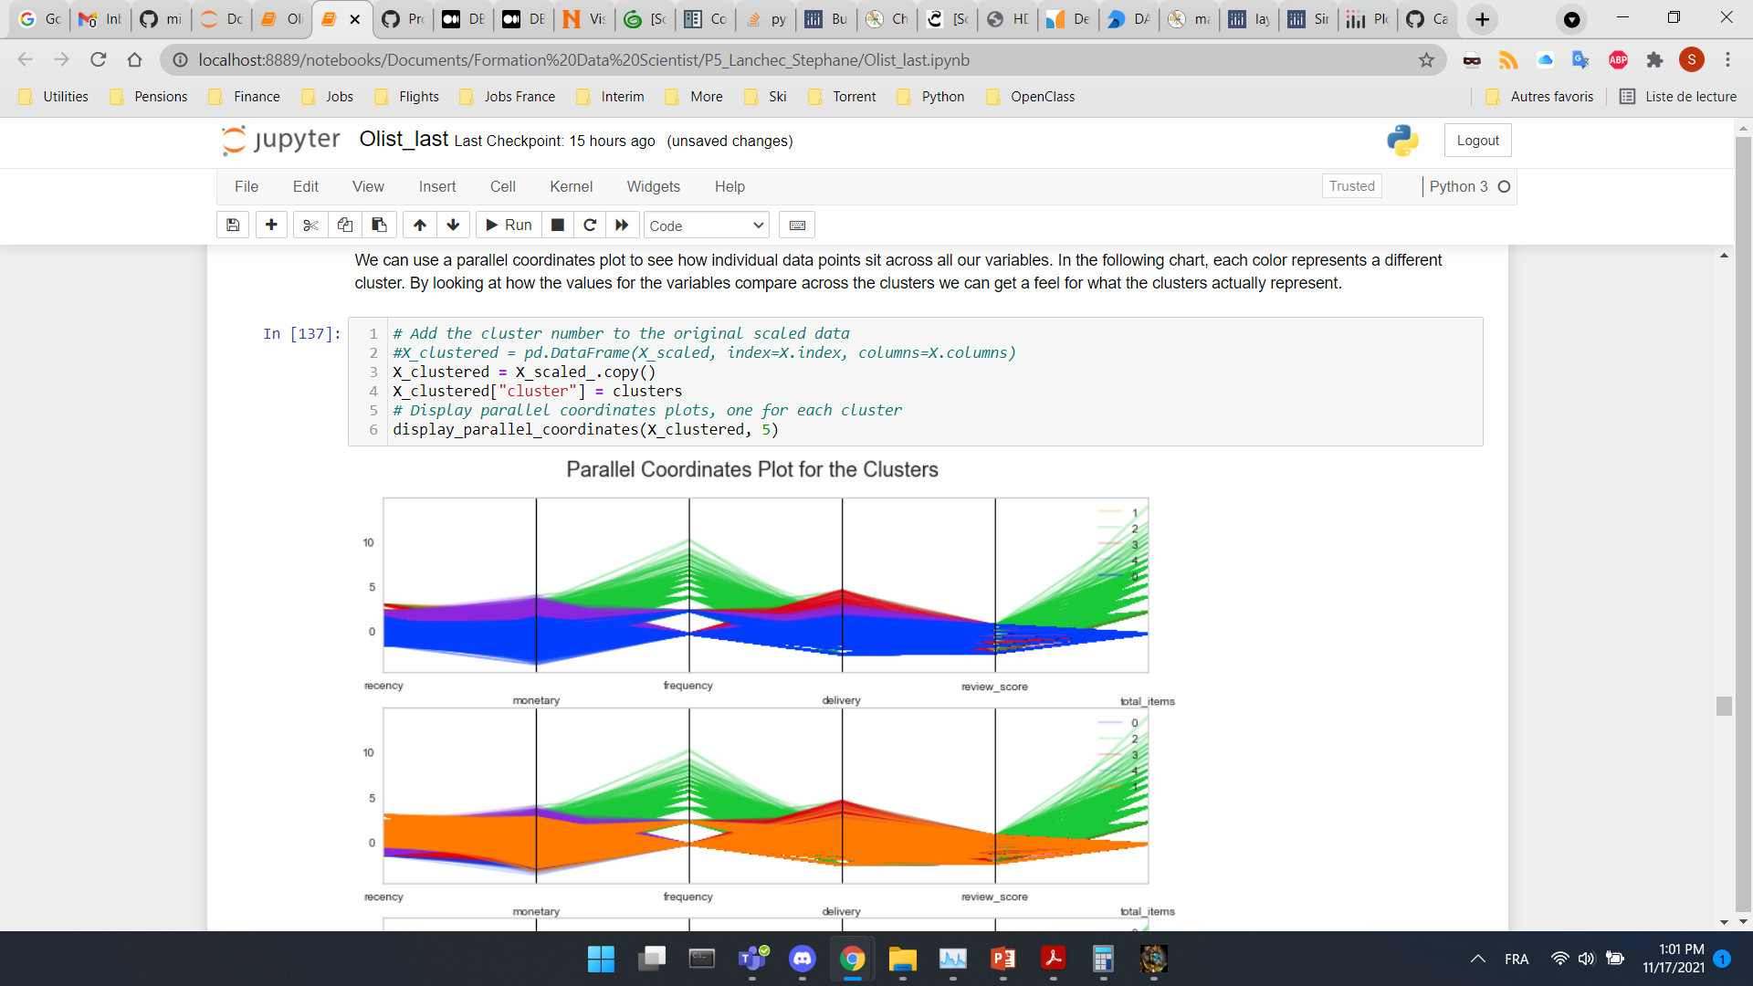
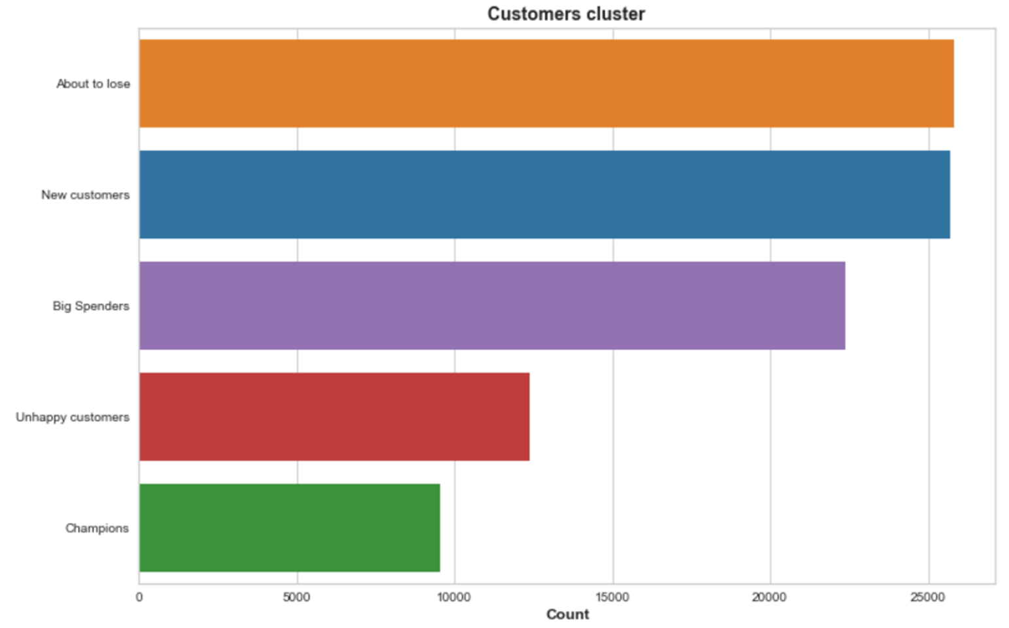
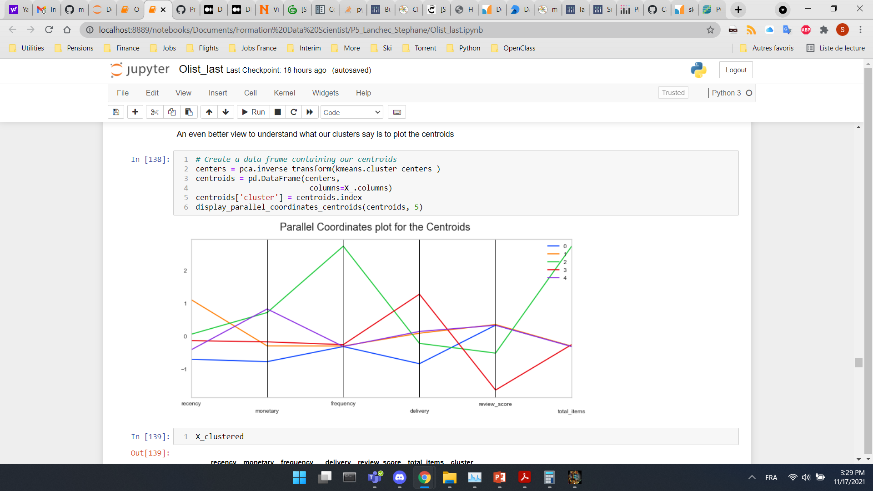
Understanding our clusters ENHANCED RFM clustering
Parallel Coordinates Plot for the clusters
Cluster 0: New customers
Cluster 1: About to lose
Cluster 2: Top customers
Cluster 3: Unhappy customers
Cluster 4: Big spenders
Parallel Coordinates Plot for the centroids

Slide 26
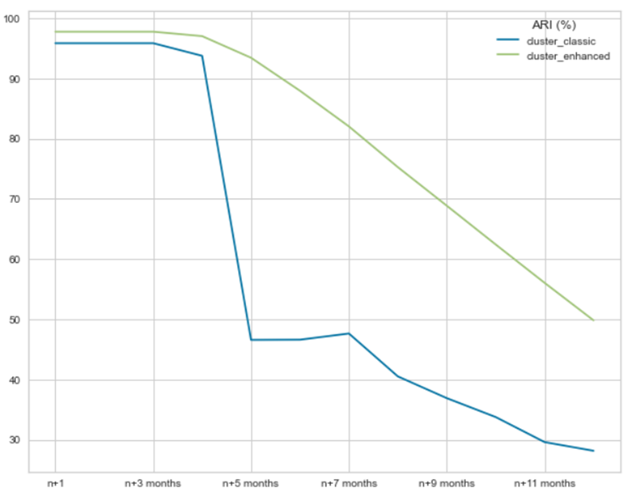
SEGMENTATION MAINTENANCE
Fixed Time period of 1 year shifted 30 days forward from first date
Fixed period of 365 days
365 days
n+1
First
date
n
n+2 months
.
.
.
n+12 months
Last
date
4 months maintenance plan for classic RFM clustering
5 months maintenance plan for enhanced RFM clustering

Slide 27
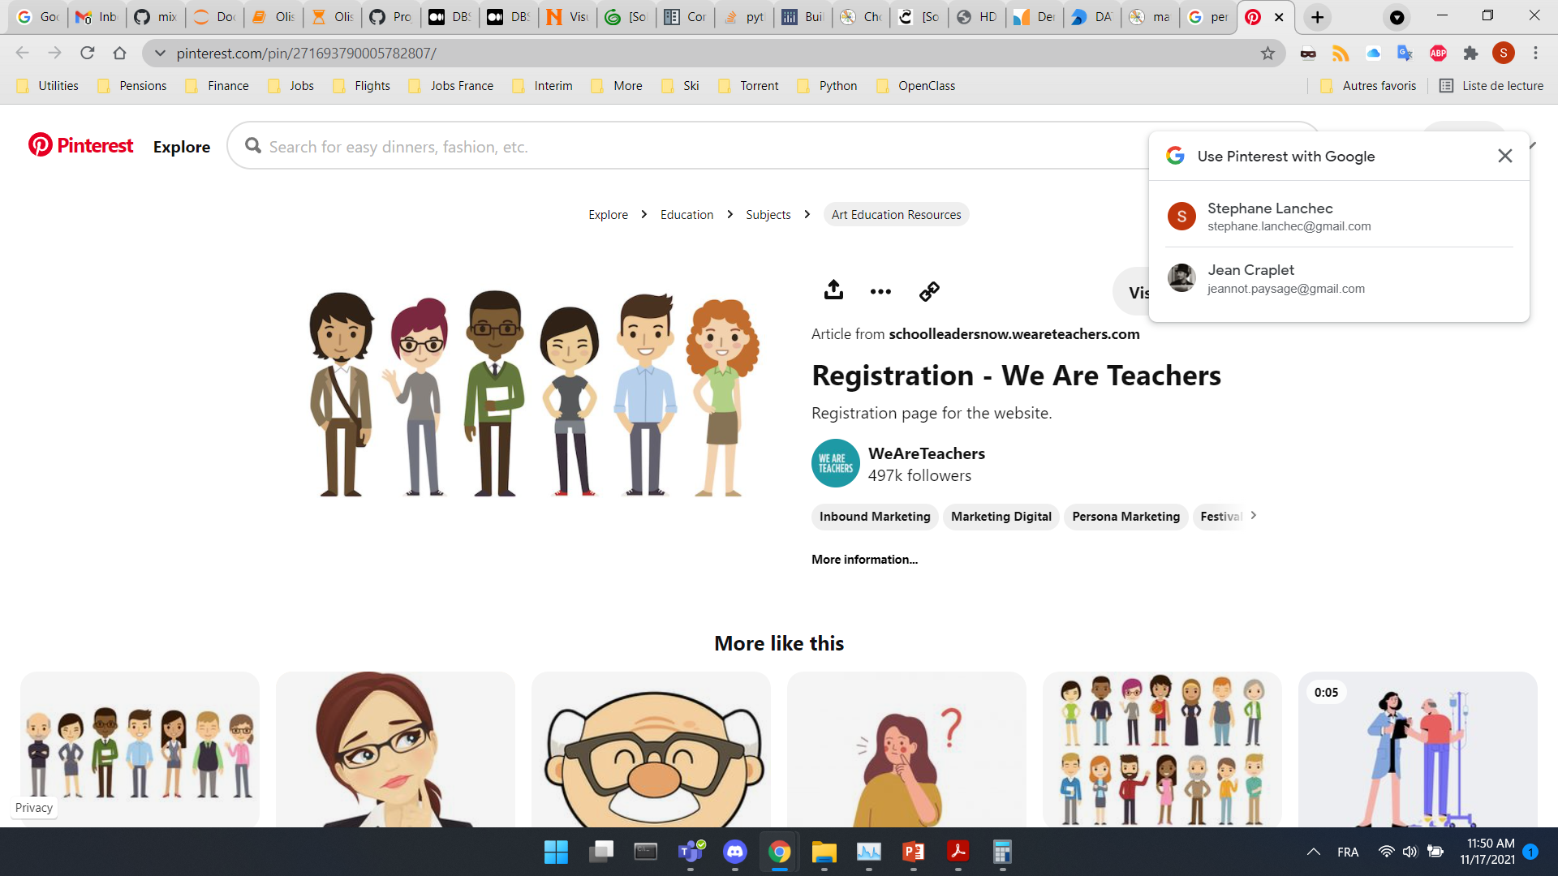

CUSTOMERS CLUSTERING TARGET
Cluster: 0 1 2 3 4
Category: New Customers About to lose Top Customers Unhappy Customers Big Spenders
Proportion: 27% 27% 10% 13% 23%
Proposed Marketing Strategy
Heavy discount campaigns
Delivery strategy
Upsell most expensive items
Cross Sell Recommendations
Price incentives and Limited time offer
Aggressive price incentives and personalized offers
Offer Limited edition and Loyality programs

Slide 28
Conclusion
3 different methods have been implemented: 1 supervised RFM + 2 unsupervised RFM
Kmeans advantages:
Automatic clustering (no need to assign scores) – Time gain
Can prevent wrong assignment
Work with more than 3 features – Better understanding of customers behavior
A maintenance plan every 4-5 months to consider
Going further
Investigate more unsupervised clustering algorithms
Investigate the addition of additional features

